Slide 1


Topic :Software solution to identify the end receiver of a cryptocurrency transaction Domain : Cyber Security Team ID :T228 Team name :Hackers Team members :T.BhavanaSri(2303A52428) T.Ravali(2303A52408) O.Sai Keerthana(2303A52397) P.Ashwitha(2303A52420) T.Vardhan(2303A52384)

Slide 2

Objective
Purpose:
1. Combat the misuse of cryptocurrencies in drug trafficking.- Assist Drug Law Enforcement Agencies in tracing illicit crypto transactions.
Main Goals:
1. Identify the final recipient (real-world entity) of funds in drug-related cases.
Detect and map wallet addresses involved in laundering processes (e.g., mixers, tumblers, bridges).
Expected Outcomes:
Enable quicker identification and prosecution of offenders.
Enhance investigative capabilities in drug law enforcement.

Slide 3
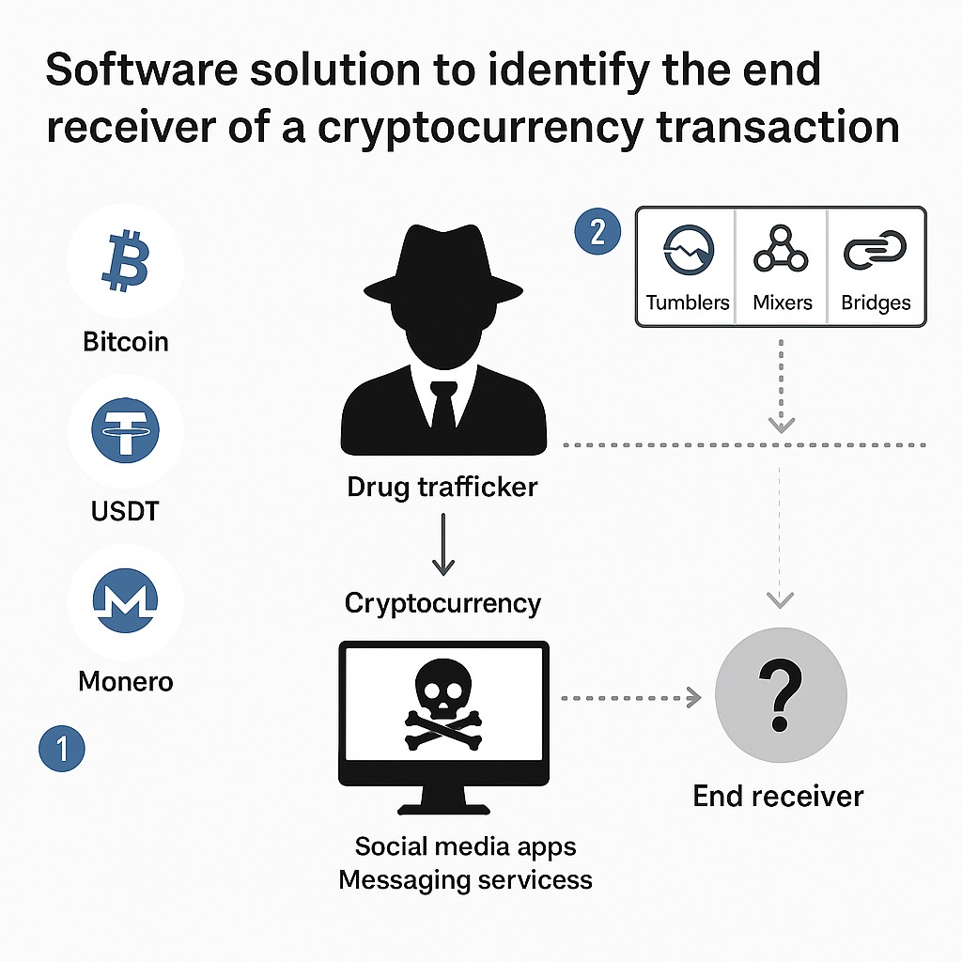
Problem Statement
* Police and drug enforcement agencies do find some crypto wallet addresses or transaction details during investigations.
* They can’t easily find out who ends up with the money.
*Crypto doesn’t use real names .
*Just wallet addresses Criminals use clever tricks to hide where the money goes. There’s no good software that can track the money and link it to real people.
Challenges:
1.Use of Anonymization Tools
2.Adoption of Privacy Coins
3.Gap Between Digital Trails
and Real-World Identities

Slide 4
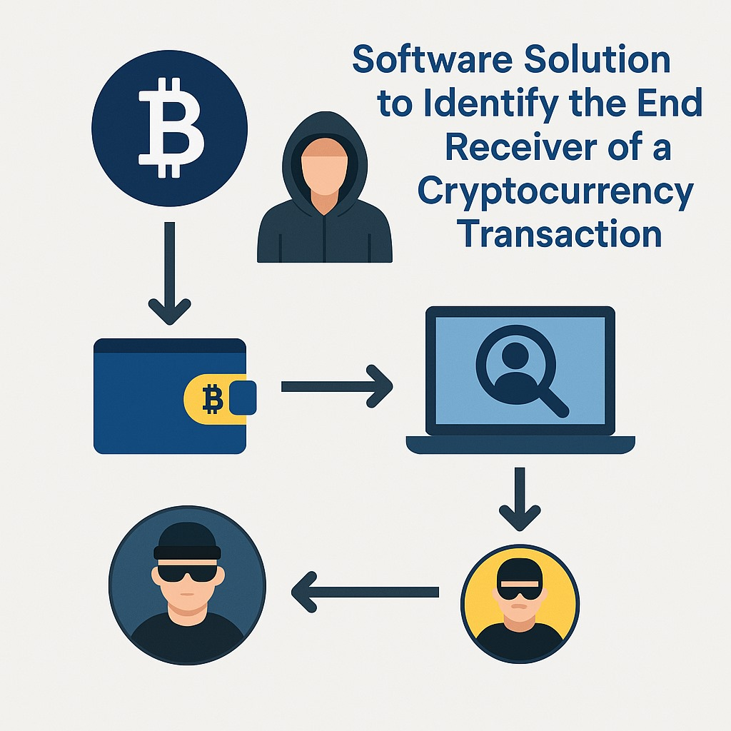
Existing system
Limitation | Current System | New System Need
. Lack of Real-Time Analysis | Most systems provide post-transaction analysis, which can delay investigations. | A real-time monitoring solution is required for proactive identification and immediate follow-ups.
Limited Cross-Platform Detection | Current tools mainly focus on a single blockchain network, often missing cross-chain interactions. | Cross-chain capabilities are crucial for identifying multi-chain transactions and tracking funds that hop between different platforms.
Manual Effort | Investigations still require significant manual effort and human interpretation to connect the dots. | Automation, machine learning, and advanced clustering algorithms will reduce manual effort and speed up the identification process.

Slide 5
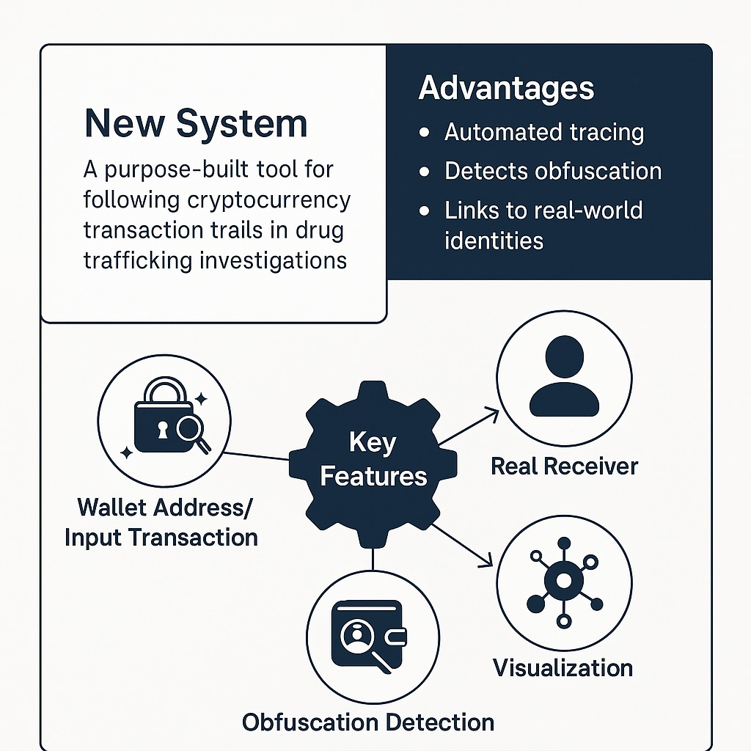

Proposed system

Slide 6
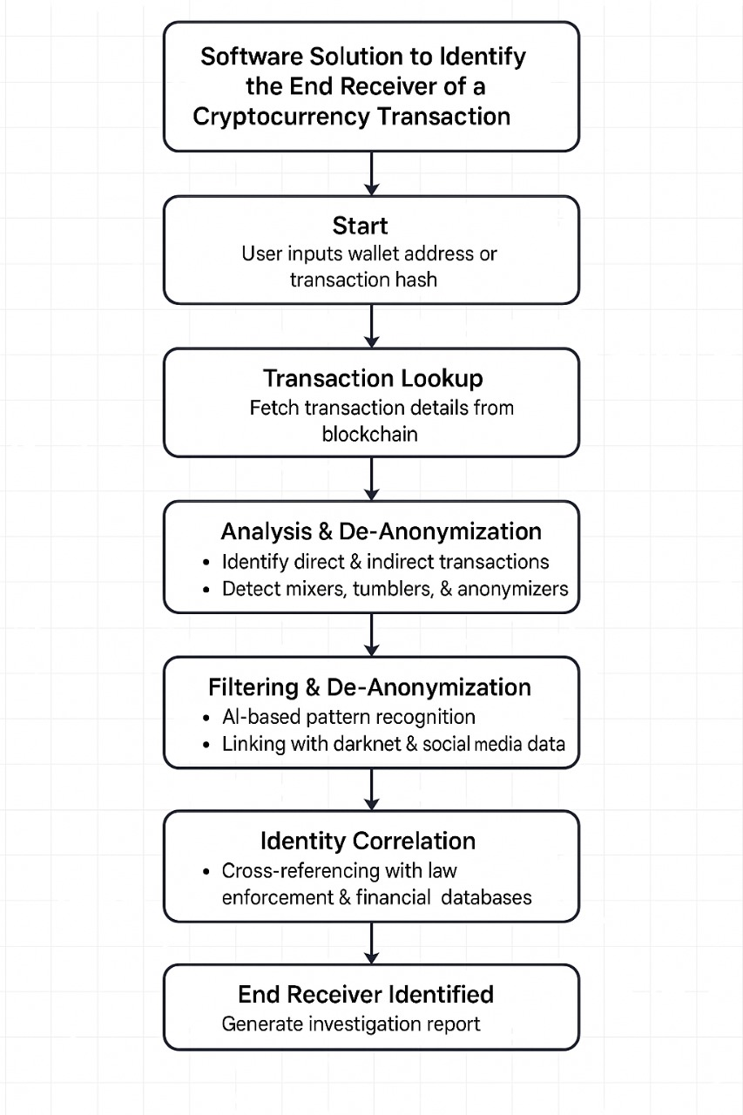
Workflow

Slide 7
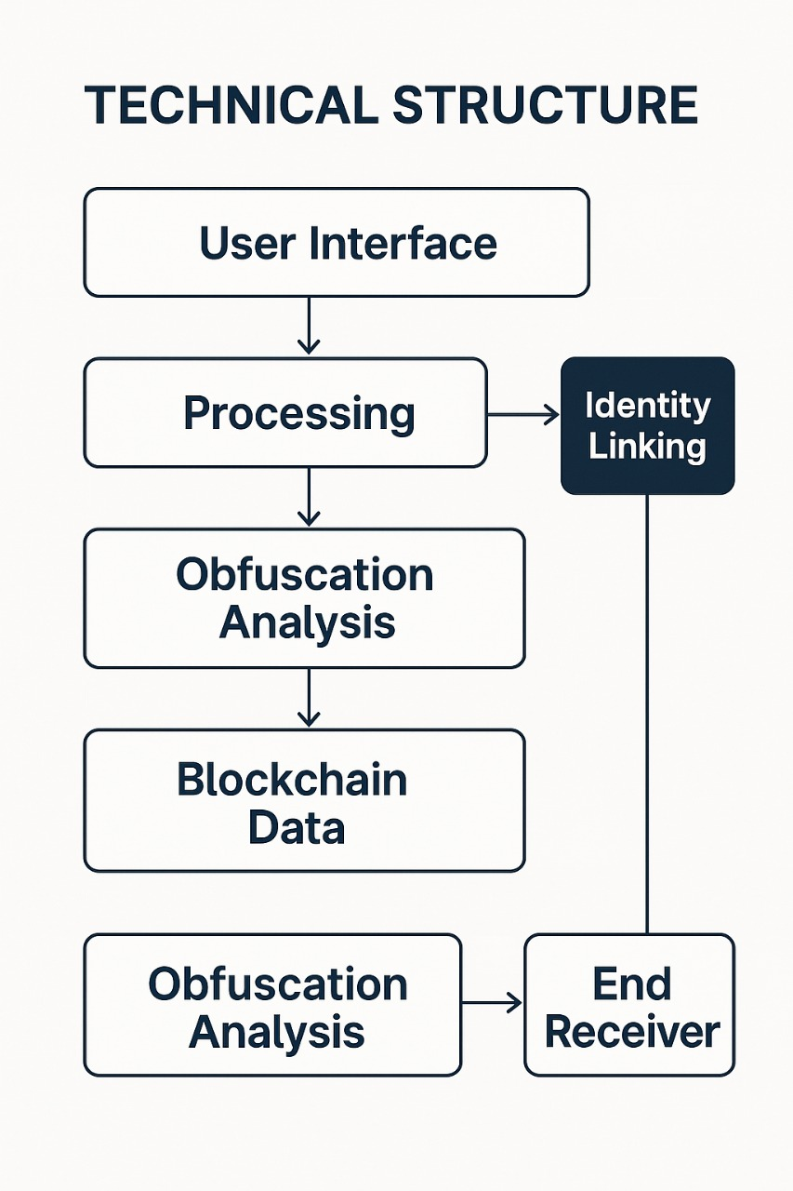
System Architecture
Tech Stack
Key points to cover
Languages Used: Python, JavaScript, C++
Database: PostgreSQL, MongoDB
Security: Encryption, Data Anonymization Techniques
Hosting: AWS/Azure Cloud
Blockchain APIs: Chain alysis, Elliptic, Open Sea APIs

Slide 8
Conclusion & Future Scope
Key takeaways:
*Law Enforcement Agencies face major challenges in tracing the flow of illicit funds due to anonymization tools like mixers, tumblers, privacy coins, and multi-layered transactions.
*A dedicated software solution is being developed to trace cryptocurrency transactions and identify the real end receiver of funds in drug-related activities.
🌟 Impact and Benefits:
🔍 Enhanced Investigative Power
🧠 Smarter Detection
🔗 Bridging Digital and Real World
🔧 Potential Improvements & Future Enhancements
*Integration with global crypto exchange APIs for real-time tracking.
*Machine learning models to predict suspicious behavior patterns.
*Support for more privacy-focused blockchains (e.g., Zcash, Dash).

